Slide 1

College admission system

Slide 2
Project College Admission System 2019
Project Completed by: Group Members
Student Number | Surname | Name
216005496 | Matsolo | Yolanda
216008775 | Oliphant | Itumeleng
215089774 | Tholwana | Leponesa
215090829 | Gingoes | Ofentse
216008684 | Thaele | Neo
214114775 | Ntsapi | Paballo

Slide 3
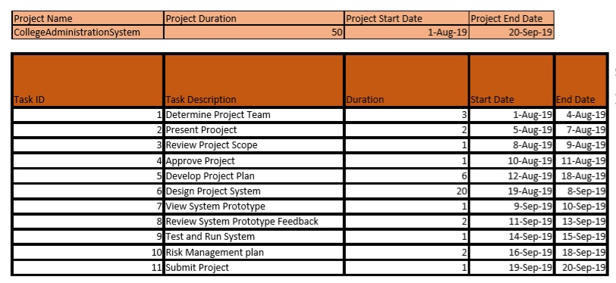
Work Break-Down Structure

Slide 4
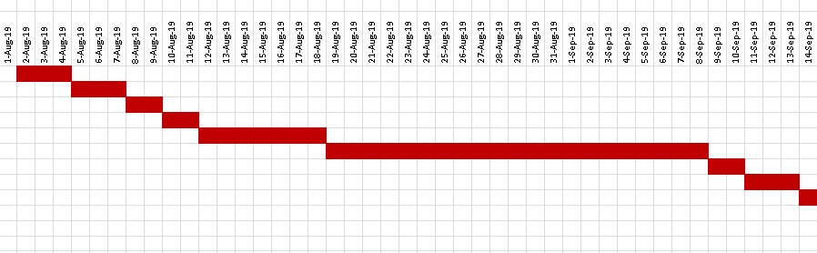
Gantt chart
Determine Pro Team
Present Project
Review Pro Scope
Approve Project
Develop Pro Plan
Design Project System
View System Prototype
Test & Run System
Submit Project

Slide 5


Requirements Workflow: Use Case Diagram
Login
Reset
Password
Update personal Info
Set Roles
Add Course
Admin
View Data
textbooks
Generate Reports
Approve/Disapprove
Student
Books
Logout/ Exit
Registration
View Available
books
Buy/Sell books
View Courses
Anonymous User
(
s
)
Apply
Calculate APS

Slide 6
Anonymous Users Use Case
View Courses
Apply
Calculate APS
Exit
Anonymous User(s)

Slide 7
Use Case: View courses Applying, or Calculating APS Brief Description: Anonymous User applying for admission Step By step Description:
1. | Anonymous user may be able to view courses offered by the institution.
2. | Anonymous user may be able to apply for all courses offered by the institution.
3. | Anonymous user may also be able to calculate APS

Slide 8
Admin Use Case
Login
Change Password
Reset
Password
Update Personal
Info
Admin
Set Roles
Add
Course
Logout/ Exit
View Data
Generate
Reports
Approve/Disapprove
Book

Slide 9
Use Case: Authenticate User, Login, or Course Cancellation Brief Description: Admin Identifying identity of User Step By step Description:
Admin can give you roles and update them,ensures that the individual using the system is recognised.
Admin can login to the system.
Admin should be able to update personal Information

Slide 10
Admin should be able to add course or subjects
Admin should be able to view data(Statistics)
Amin should be able to generate reports
Admin should be able to approve or disapprove books to be sold
Admin should be able to change password

Slide 11
Student Use Case
Login
Registration
Student
Update
personal
Info
Logout/ Exit
nd
Buy/Sell 2
Hand books
Reset Password
View available
books

Slide 12
Use Case: Login, Reset Password, Register, view and sell 2nd hand books and update info Brief Description: Student Admitted to the Institution Step By step Description:
Student should be able to login to the system
Student should be able to Update his/her personal Information
Student should be able to buy or sell second hand text books through the system
Student should be able to Reset his/her password
Student should also be able to Register to the relevant course
Student should be able to view available books

Slide 13
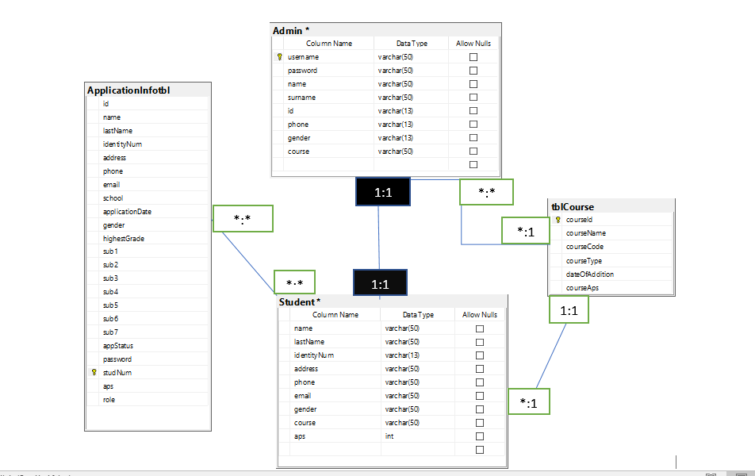
ERD

Slide 14
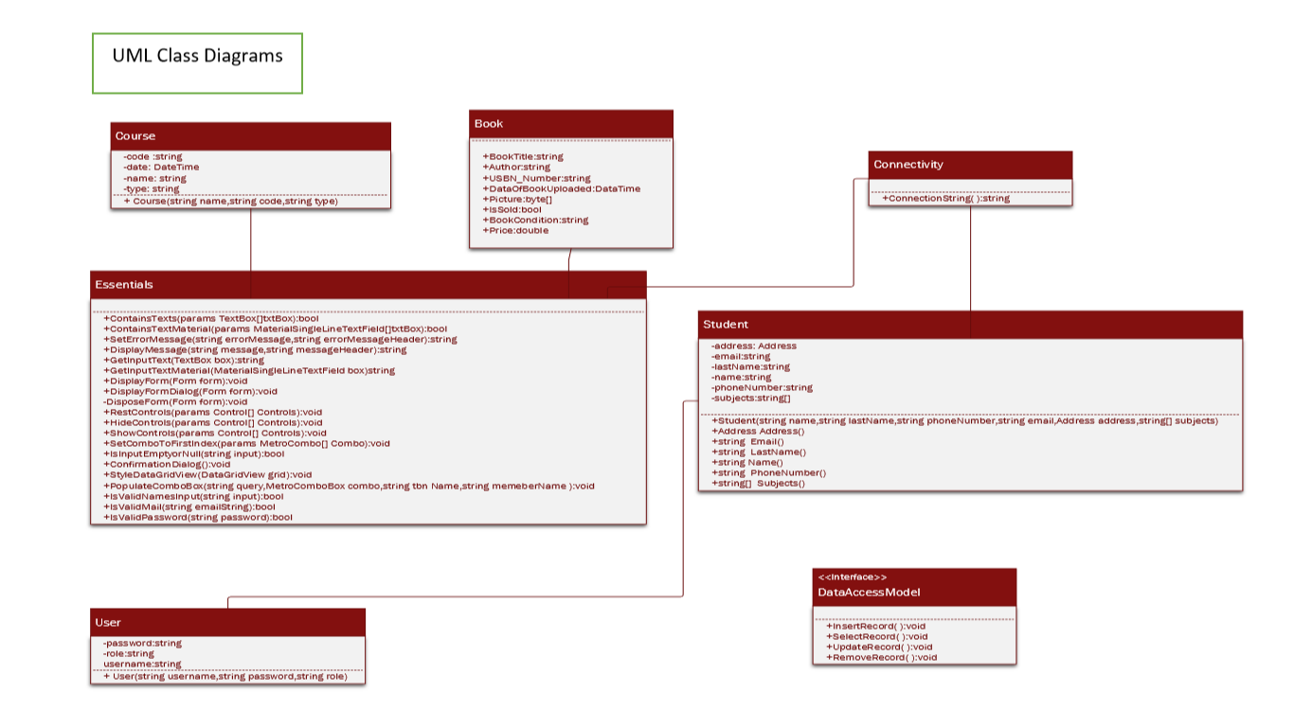
UML Diagram
I

Slide 15
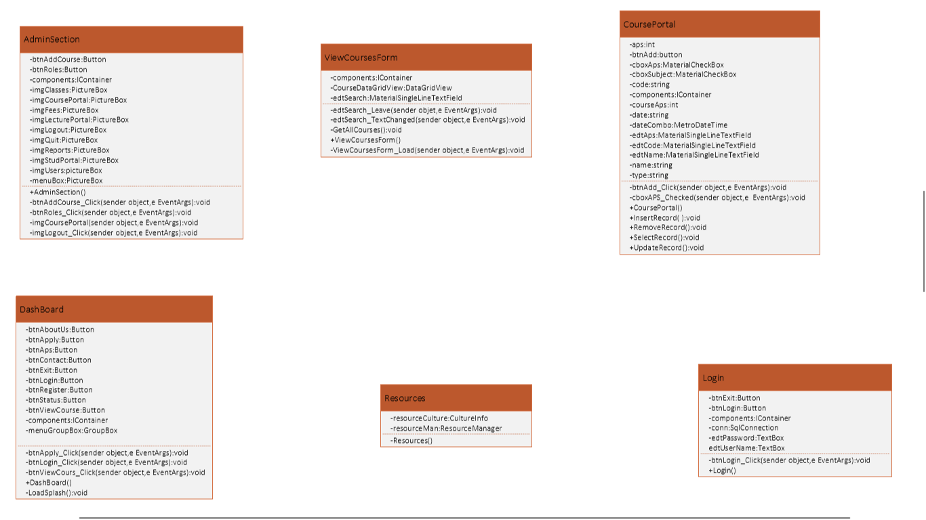
The GUI

Slide 16


